Slide 1

What is a VPN and what does it mean?

Slide 2

What is a VPN and what does it mean?
VPN stands for "virtual private network" — a service that helps you stay private online. A VPN establishes a secure, encrypted connection between your computer and the internet, providing a private tunnel for your data and communications while you use public networks.
While VPNs were once novel tech solutions, they are now necessary tools. At the basic level, VPNs protect your privacy online so you cannot be targeted or discriminated against based on location.
If you’re still a bit unclear on what VPN means, you can try to visualize it. Imagine that the internet is a real highway, and we zip around it on motorcycles. We visit our favorite locations (websites), make purchases in shops, check our stock portfolio, read the news, play games, and more.
Sitting on a motorcycle, you’re completely visible. Anyone with a mind to do so can follow you along these digital highways, see who you are, and peek into your private life. To view your online activity, who you are, where you like to visit, and more, all anyone has to do is look. Worse, they can follow you home. You’re traceable.
Instead of riding on the wide open internet highway, you can use a private tunnel instead: a virtual private network. A VPN acts as your own personal tunnel that encircles you, masking you in anonymity and blocking anyone from seeing where you’re going or what you’re doing. To abandon the metaphor, a VPN encrypts your connection and hides your IP address.

Slide 3

What does a VPN hide?
VPNs work on the operating system level, so they reroute all your traffic through other servers. That means all of your online traffic, along with your physical location, stays hidden while you surf the web. When you access a site through a VPN server, the source of your connection is shown as one of the many VPN routers — called a proxy server — not your own. So the owners of the site, and anyone else trying to spy on you, cannot deduce who you are.
A VPN is the closest you can get to true anonymity online without using the Tor network, which bounces your connection around a widely distributed network of volunteer relays, basically keeping your web activity in constant motion so nobody can focus on it. VPNs do not use this (very slow) protocol, but they do offer sufficient — and essential — protection as you cruise through today’s deregulated and hacker-lined cyber highways.
When it comes to online privacy solutions, VPN, Tor, and web proxies are all options — but a VPN offers the best balance of comprehensive security and speed.
Whether you want to stay safe on public Wi-Fi, protect your online banking info, or disguise your location from content providers and advertisers, a VPN will keep you private.

Slide 4
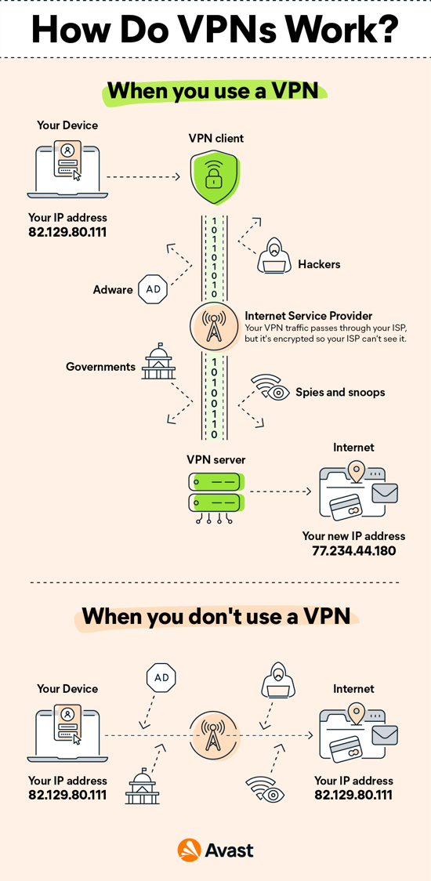
How do VPNs work?
The Virtual Private Network was first developed by Microsoft in 1996 as a way for remote employees to securely access the company’s internal network. Once it doubled company productivity, other companies began to adopt the practice. Corporate VPNs that allow remote work are now a standard feature of the global business landscape.
Developers then realized that this secure “tunnel” could be utilized by average people who wanted to securely connect to the largest network on the planet: the world wide web. VPNs are now the cornerstone of online privacy in the consumer sector.
What does a VPN do?
Instead of sending your internet traffic (e.g. your online searches, uploads, and downloads) directly to your Internet Service Provider (ISP), a VPN first routes your traffic through a VPN server. That way, when your data is finally transmitted to the internet, it appears to come from the VPN server, not your personal device.
Without a VPN, your IP address — a special number unique to your home network — is visible to the web. A VPN masks your IP address by acting as an intermediary and rerouting your traffic. It also adds encryption, or a tunnel around your identity, as you connect. The combination of the VPN server and the encryption tunnel blocks your ISP, governments, hackers, and anyone else from spying on you as you navigate the web.

Slide 5


Why use a VPN?
Do you really need a VPN? Short answer: yes. There are several important reasons why you need a VPN, the two main purposes being privacy and access.
Public Wi-Fi networks, such as those found in coffee shops, airports, and other public areas are incredibly risky. All it takes is one hacker connected on the same network, and they can easily spy on all your activity. A VPN acts like an invisibility cloak, hiding everything you do on your phone or computer and protecting you even from evil twin attacks.
And why use a VPN at home? VPNs also allow you to hide from your internet service provider (ISP), governments, and advertisers… so you can avoid censorship, price discrimination, and geo-blocks on media.
In 2017, the US abandoned net neutrality — the principle that ISPs should treat all internet data equally — and various lawsuits continue over the issue. The complete elimination of net neutrality would free ISPs to collect and sell your personal data, including your browsing history, physical location, health info, and even your social security number. It would also permit ISPs to slow down your connection if you do a lot of downloading and streaming, and otherwise discriminate against certain internet users. A VPN blocks your ISP from seeing your browsing history and other personal data.

